Slide 1
Simulation
Computational thinking

Slide 2
Principles of simulation

Slide 3
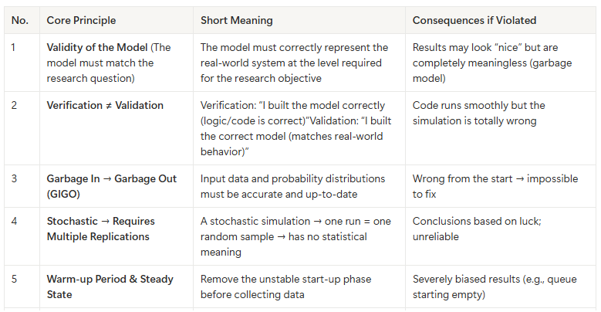

Slide 4
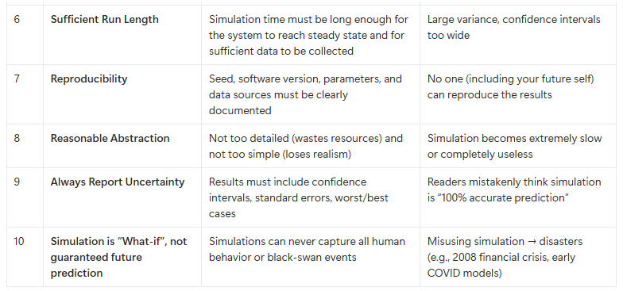

Slide 5
Critical aspects

Slide 6
Model Validity
Does the model actually represent reality correctly for the question you're asking? Over-simplification (abstraction) can kill accuracy.

Slide 7
2. Input Data Quality & Distribution
Garbage in → Garbage out.
Wrong or outdated data, or incorrect probability distributions (e.g., using uniform instead of exponential for service times) completely invalidate results.

Slide 8
3. Randomness and Number of Replications
Most simulations are stochastic → a single run means nothing. You need multiple independent replications with different seeds to compute confidence intervals.

Slide 9
4. Warm-up Period & Run Length
Systems often start empty/idle (transient phase). You must discard the warm-up period to reach steady-state, and run long enough for statistical significance.

Slide 10
5. Verification vs Validation
- Verification: “Did I build the model right?” (code runs as intended)
- Validation: “Did I build the right model?” (output matches real-world data)

Slide 11
6. Level of Detail
Too detailed → computationally expensive and slow.
Too coarse → misses important behavior. Choose based on the research question.

Slide 12
7. Variance Reduction Techniques
Methods like Common Random Numbers, Antithetic Variates, Importance Sampling help you get reliable results with far fewer runs

Slide 13
8. Sensitivity Analysis
How much does output change when you slightly tweak inputs? Identifies critical parameters and uncertainty

Slide 14
9. Reproducibility
Document everything: seeds, software version, parameters, data sources. Others (or future-you) must be able to reproduce exactly the same results.

Slide 15
10. Computational Cost
Some simulations (agent-based, high-fidelity) can take days/weeks. Consider approximations, metamodels, cloud/GPU, or surrogate models.

Slide 16
11. Understanding the Limits
Simulation is “What if?”, not prophecy.
You can never perfectly model human behavior, rare events, or unknown unknowns.
Always report uncertainty (confidence intervals, scenarios).

Slide 17
Checklist
1. Is the model conceptually correct? (Validity)
2. Does the code implement the model correctly? (Verification)
3. Do results match real-world observations? (Validation)
4. Have I run enough replications and long enough? (Statistical reliability)
5. Have I clearly communicated the uncertainty?

